Slide 1
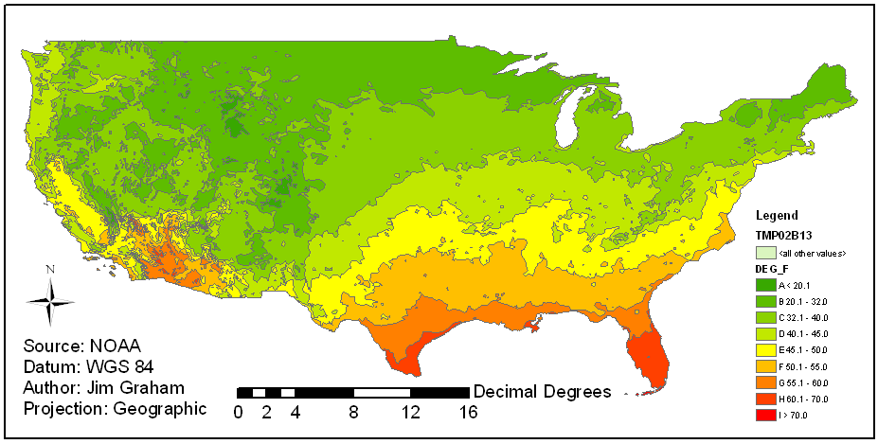
US Temperature Range
Notes:
This is a shapefile of polygons indicating tempature range for the contintental US
The original data is from weather stations scattered across the US
The data was “interpolated” into a raster and then converted to polygons

Slide 2
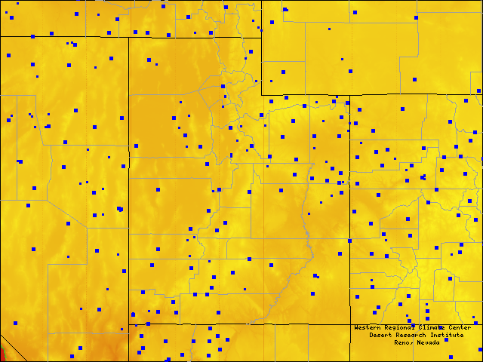
US Weather Stations
~450 km
http://www.raws.dri.edu/

Slide 3

Interpolation
Interpolation is a method of constructing new data points within the range of a discrete set of known data points.
Notes:
This is from species richness data in Rocky Mountain National Park

Slide 4
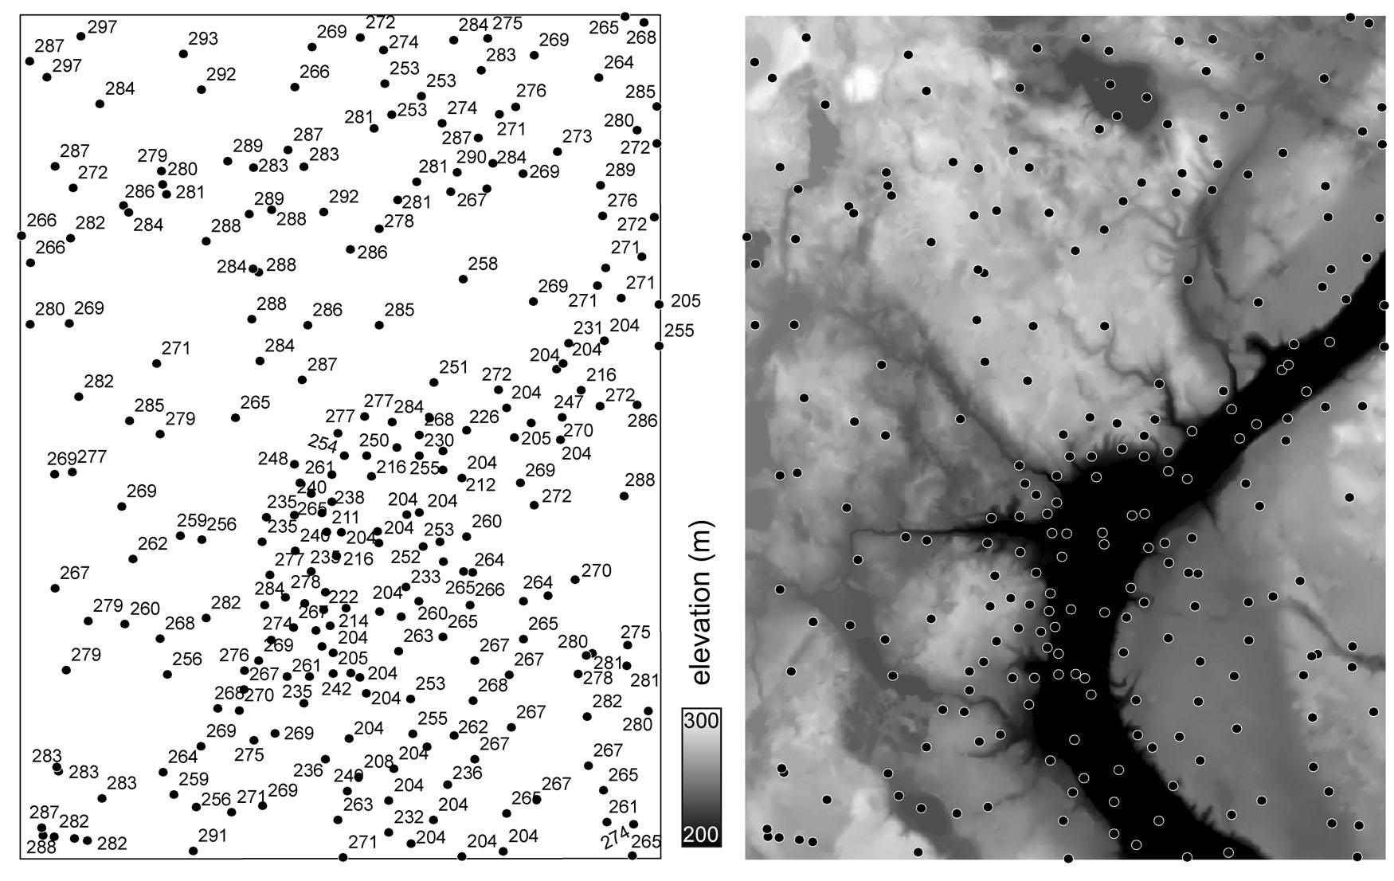
Elevation (DEM)
Bolstad

Slide 5
First Law of Geography
“Everything is related to everything else, but near things are more related than distant things”
  Waldo Tobler

Slide 6
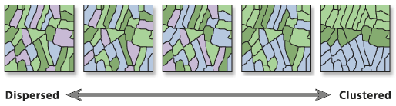
Measuring Autocorrelation
Moran’s I
  In ArcMap: Spatial Statistics Tools -> Analyzing Patterns -> Spatial Autocorrelation (Moran’s I)
0 ~ Random
1 = Perfect Correlation
-1 = Perfect Dispersion (pattern)
ArcGIS Help

Slide 7
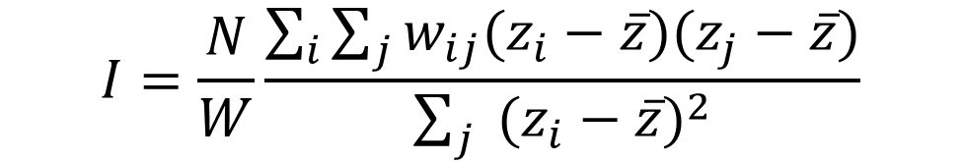
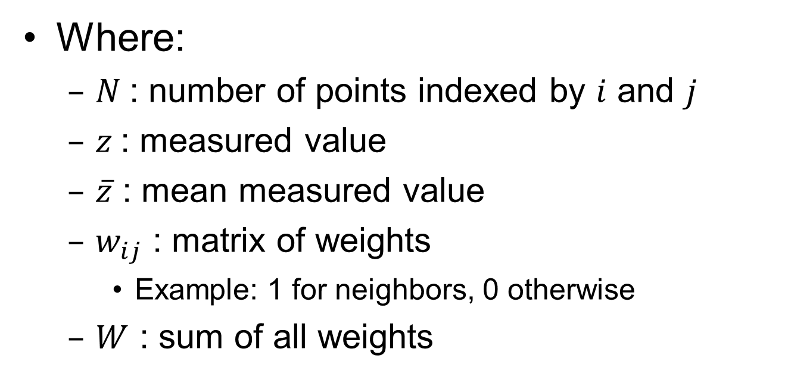
Moran’s I
$$I=\frac{N}{W}\frac{\sum_{i}{\sum_{j}{w_{ij}(z_{i}−\overline{z})(z_{j}−\overline{z})}}}{\sum_{j}{ {(z_{i}−\overline{z})}^{2}}}$$
Where:
  $N$: number of points indexed by $i$ and $j$
  $z$: measured value
  $\overline{z}$ : mean measured value
  $w_{ij}$ : matrix of weights
    Example: 1 for neighbors, 0 otherwise
  $W$ : sum of all weights

Slide 8
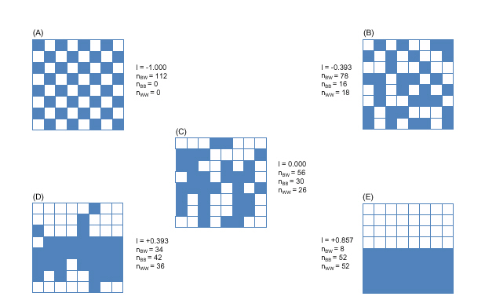
Moran’s I

Slide 9

Moran’s I Results
0.8 = Spatial Autocorrelation
-0.05 = Random
-1 = Opposite of autocorrelation

Slide 10
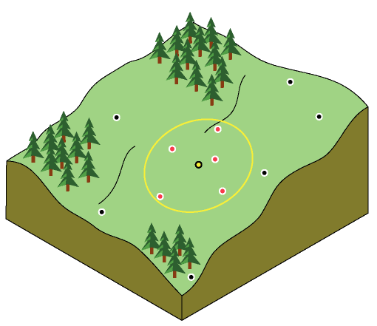
Inverse Distance Weighting
Points closer to the pixel have more “weight”
ArcGIS Help

Slide 11
Process
Obtain points with measurements
Evaluate data (autocorrelation)
Interpolate between the points using:
  Nearest (Natural) Neighbor
  Trend (fitted polynomial)
  Inverse Distance Weighting
  Kriging
  Splines
  Density
Convert the raster to vector using contours

Slide 12
Simple Interpolation
50
40
35
Measured Values
20
Spatial Cross-section

Slide 13
Linear Interpolation
50
40
35
Measured Values
20
Spatial Cross-section

Slide 14
Linear Interpolation
Trend surface with order of 1
50
40
35
Measured Values
20
55
47
42
36
36
37
38
40
34
28
21
Spatial Cross-section

Slide 15
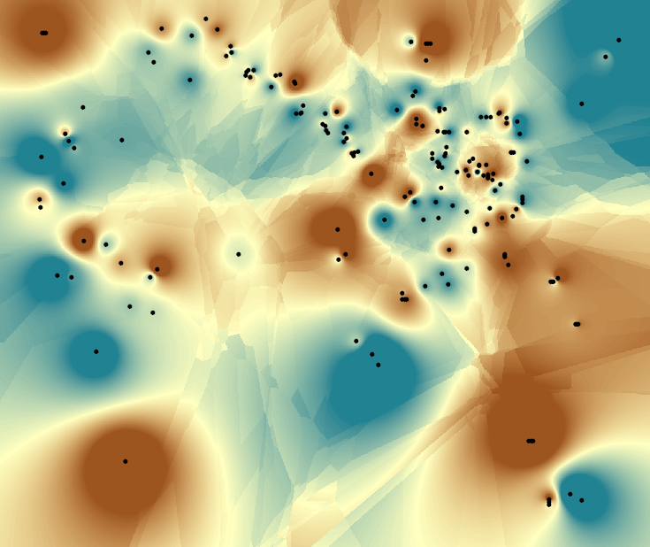
Inverse Distance Weighting
Notes:
- Commonly used where a statistical method is not required

Slide 16
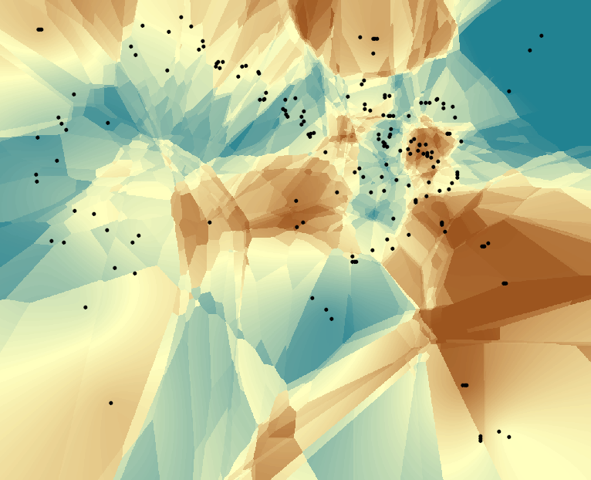
Kriging

Slide 17
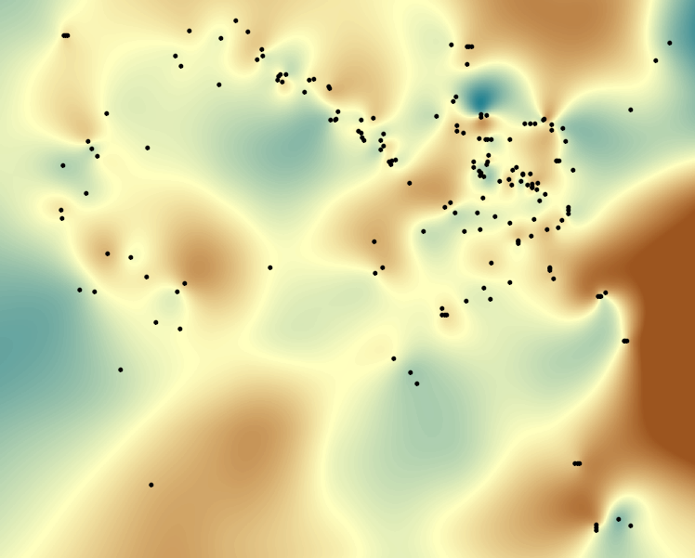
Splines

Slide 18
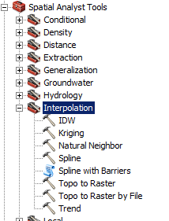
ArcToolbox
Simple Interpolation
  IDW
  Kriging
  Natural Neighbor
  Spline
  Trend
Ok for cartography
Lack the capability of the Geostatistical Wizard

Slide 19
Inverse Distance Weighting
No value is outside the available range of values
Assumes 0 uncertainty in the data
Smooth's the data

Slide 20
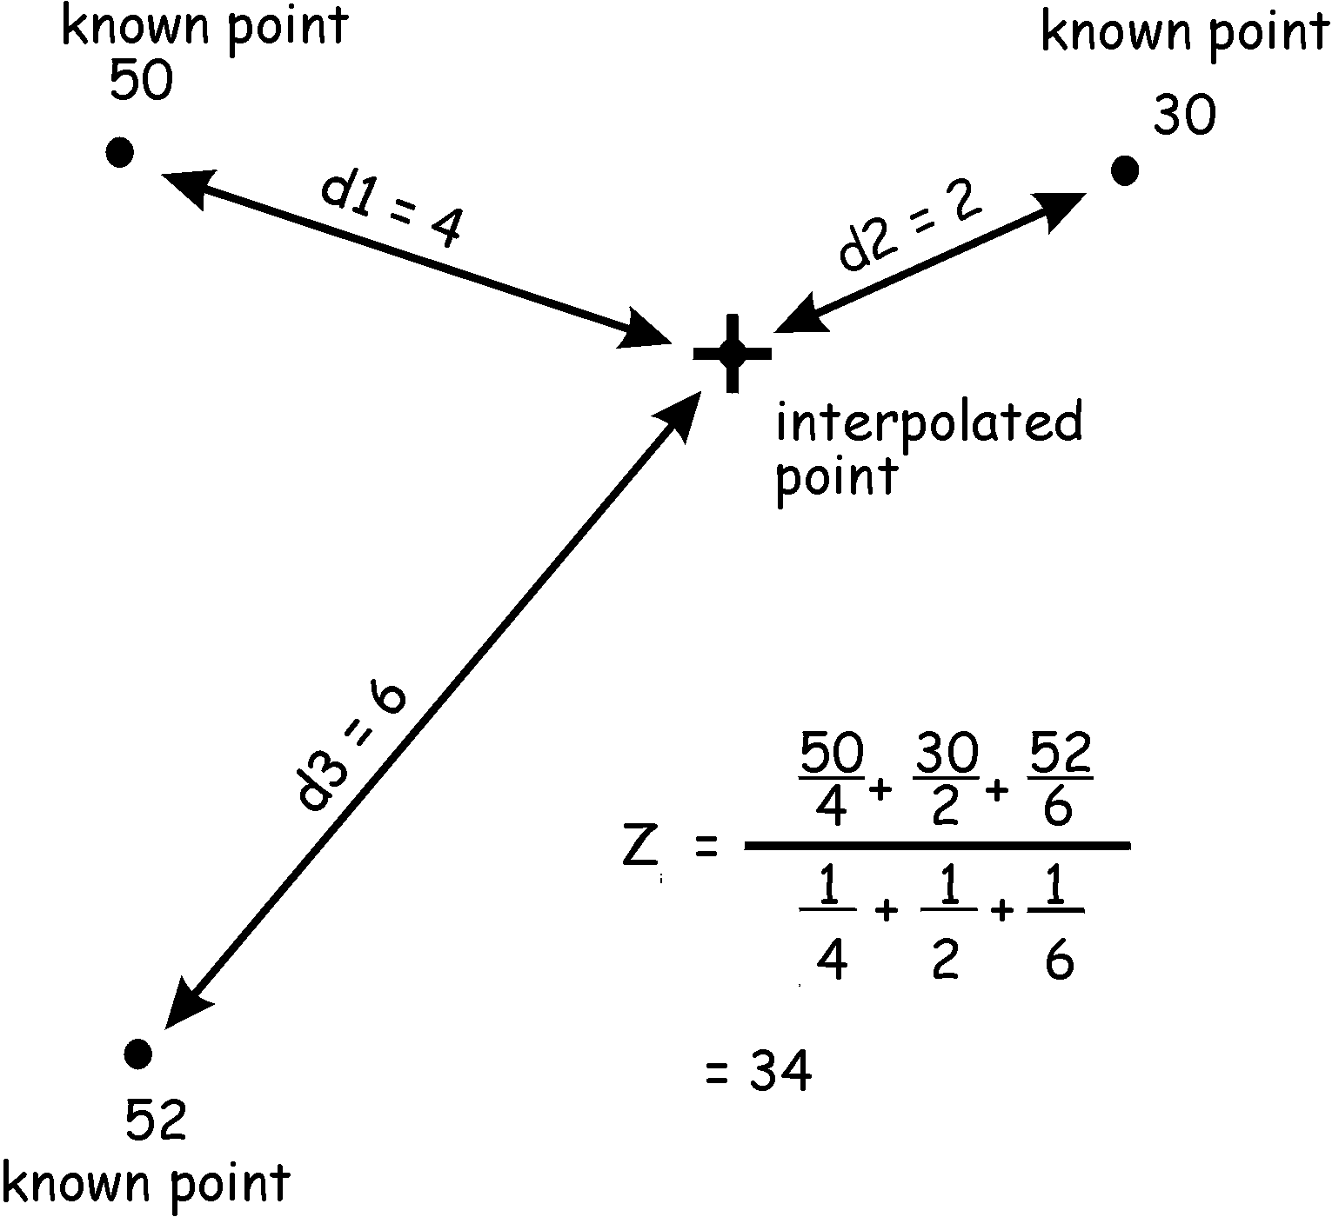
Inverse Distance Weighting

Slide 21
Kriging
Semivariograms
  Analysis of the nature of autocorrelation
  Determine the parameters for Kriging
Kriging
  Interpolation to raster
  Assumes stochastic data
  Can provide error surface
    Does not include field data error (spatial or measured)

Slide 22
Semivariance
Variance = (z_{i} - z_{j})²
Semivariance = Variance / 2
z_{j}
z_{i} - z_{j}
z_{i}
Point i
Distance
Point j
Notes:
Given two points with the z values of 0 and 2, with distance of 10 between them

Slide 23
Semivariance
For 2 points separated by 10 units with values of 0 and 2:
2
( 0 – 2 )² / 2 = 2
Semivariance
(z_{i} - z_{j})² / 2
Distance Between Points
10
Notes:
Given two points with the z values of 0 and 2, with distance of 10 between them

Slide 24
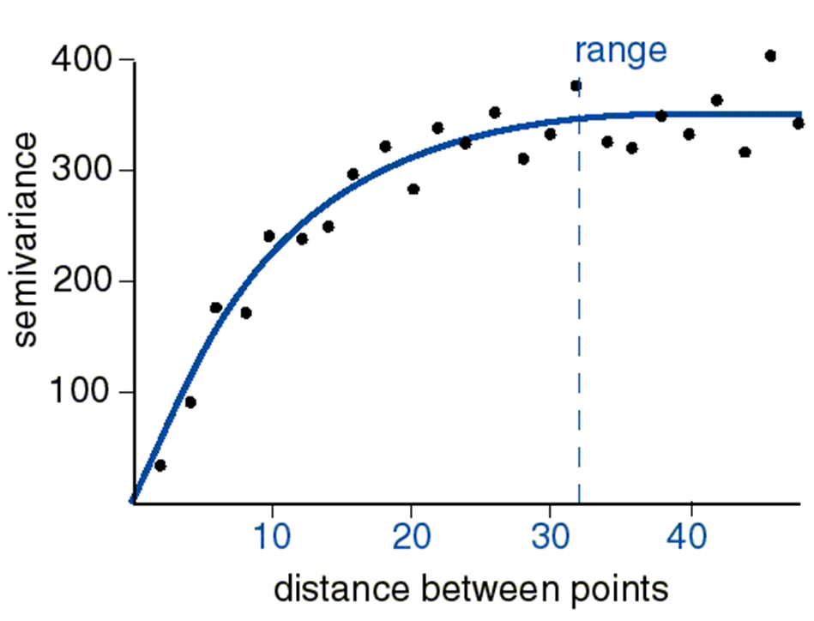
Semivariogram

Slide 25
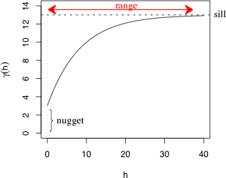
Range, Sill, Nugget
www.unc.edu
Notes:
Nugget – the difference between values when they are coincident. This is also the inherent variation in the values.
Sill – the variance between values after any effect of being close is removed.
Range – the distance for the effect of points being close to one another is removed.

Slide 26
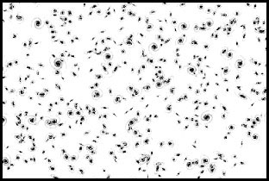
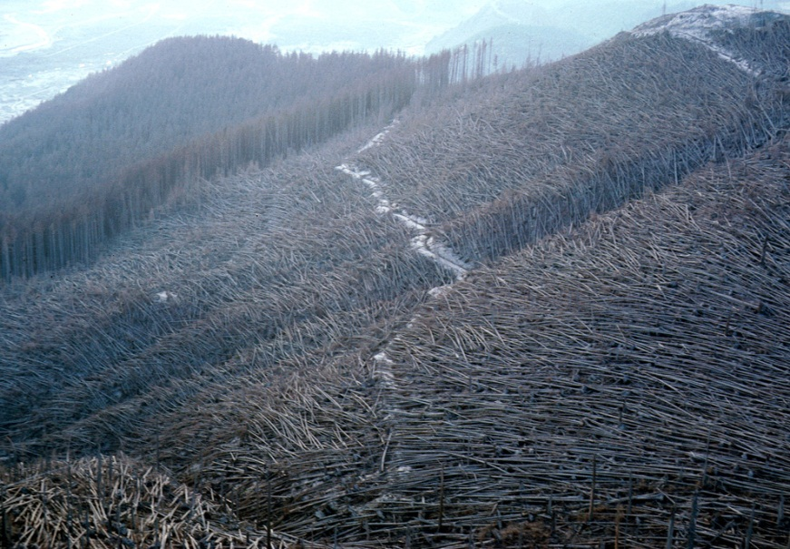
Definitions
Isotropic – Identical in all directions, direction does not matter
Anisotropic – Different in different directions, direction does matter
Distribution of galaxies
universe advanture.org
Trees blown down in St. Helens Eruption
www.boston.com

Slide 27
Interpolation Software
ArcGIS with Geostatistical Analyst
R
Surfer (Golden Software)
Surface II package (Kansas Geological Survey)
GEOEAS (EPA)
Spherekit (NCGIA, UCSB)
Matlab

Slide 28
More Resources
Geostatistical Analyst -> Tutorial
Wikipedia:
  http://en.wikipedia.org/wiki/Kriging
USDA geostatistical workshop
  http://www.ars.usda.gov/News/docs.htm?docid=12555
EPA workshop with presentations on geostatistical applications for stream networks:
  http://oregonstate.edu/dept/statistics/epa_program/sac2005js.htm
Notes:
28

Slide 29
Literature
Lam, N.S.-N., Spatial interpolation methods: A review, Am. Cartogr., 10 (2), 129-149, 1983.
Gold, C.M., Surface interpolation, spatial adjacency, and GIS, in Three Dimensional Applications in Geographic Information Systems, edited by J. Raper, pp. 21-35, Taylor and Francis, Ltd., London, 1989.
Robeson, S.M., Spherical methods for spatial interpolation: Review and evaluation, Cartog. Geog. Inf. Sys., 24 (1), 3-20, 1997.
Mulugeta, G., The elusive nature of expertise in spatial interpolation, Cart. Geog. Inf. Sys., 25 (1), 33-41, 1999.
Wang, F., Towards a natural language user interface: An approach of fuzzy query, Int. J. Geog. Inf. Sys., 8 (2), 143-162, 1994.
Davies, C., and D. Medyckyj-Scott, GIS usability: Recommendations based on the user's view, Int. J. Geographical Info. Sys., 8 (2), 175-189, 1994.
Blaser, A.D., M. Sester, and M.J. Egenhofer, Visualization in an early stage of the problem-solving process in GIS, Comp. Geosci, 26, 57-66, 2000.
Notes:
29
Fotheringham A.S., Brunsdon C., and Charlton M. 2000 Quantitative Geography: Perspectives on Spatial Data Analysis. London: Sage.
Fotheringham A.S. and O’Kelly M.E. 1989 Spatial Interaction Models: Formulations and Applications. Dordrecht: Kluwer.

